Slide 1
Brain Tumor Detection and Segmentation
An analysis and evaluation of the performance on U-net convolutional networks

Slide 2
Background
Medical field has become one of the most advanced fields in which machine learning and deep learning are applied.
Doctors need higher precision of identification to detect and then address the patient's’ medical problem.
e.g. Tumor Identification
Notes:
Tasks like tumor identification takes valuable time and effort away from health practitioners who could be spending it on higher priority tasks. Therefore, machine learning models have stepped in to assist doctors on saving them time by analyzing images magnitudes faster than the human eye could ever can at increasingly high accuracies.

Slide 3
Dataset
Brain MRI segmentation
https://www.kaggle.com/mateuszbuda/lgg-mri-segmentation
The data-set contains brain MR images together with manual FLAIR abnormality segmentation masks. The images were obtained from The Cancer Imaging Archive (TCIA). They correspond to 110 patients.
The data-set is organized into 110 folders named after case ID that contains information about source institution.

Slide 4
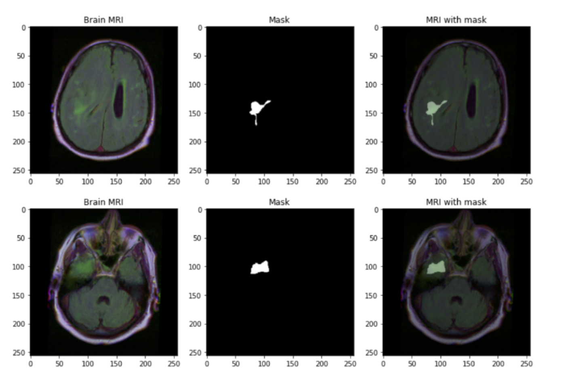
Dataset

Slide 5
Data Processing
A train-test split of 80% train and 10% validation, 10% test
Each image is loaded into a custom dataset and data loader processed with PyTorch
Notes:
Each patient had a corresponding image folder containing all of the sliced MR images, along with a mask containing the tumor location for that given slice.
split: avoid overfitting

Slide 6
Workstation details
Hardware
BU Shared Compute Cluster
1x Tesla V100
4x CPU Cores
5 hours session
Software
PyTorch 1.10
Python 3.8.6
Jupyterlab

Slide 7
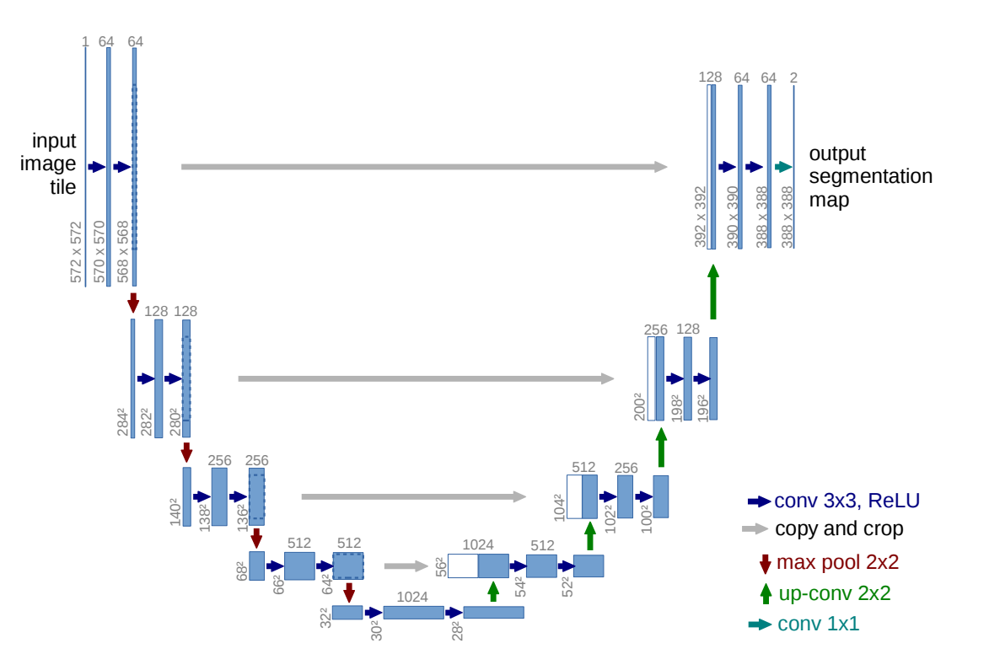
U-net
Notes:
Each blue box corresponds to a multi-channel feature map. The number of channels is denoted on top of the box. The x-y-size is provided at the lower left edge of the box. White boxes represent copied feature maps. The arrows denote the different operations.
In total the network has 23 convolutional layers.

Slide 8
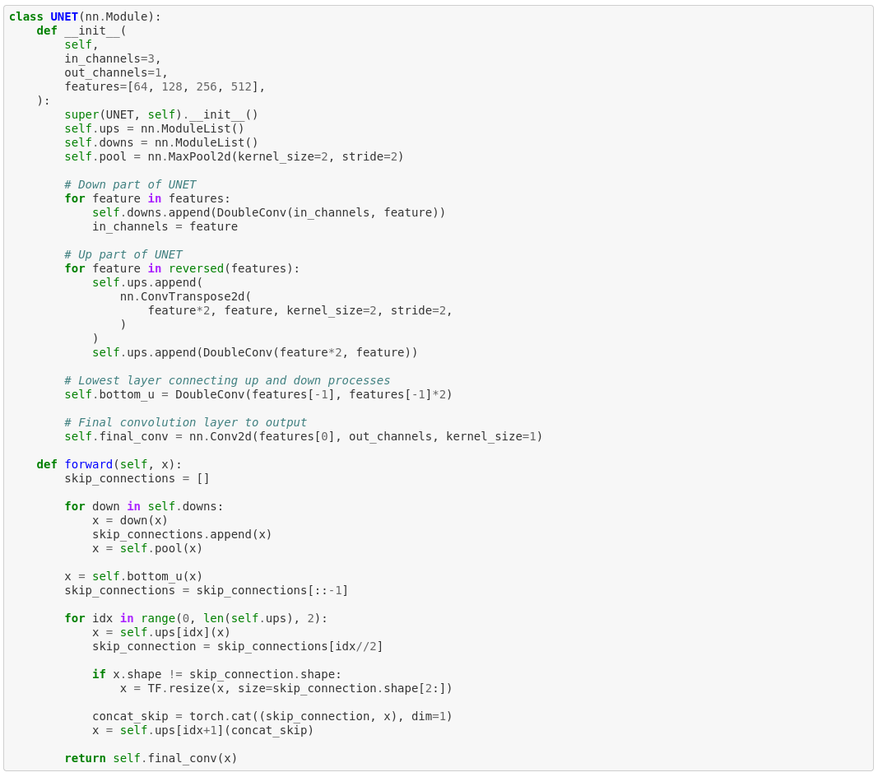
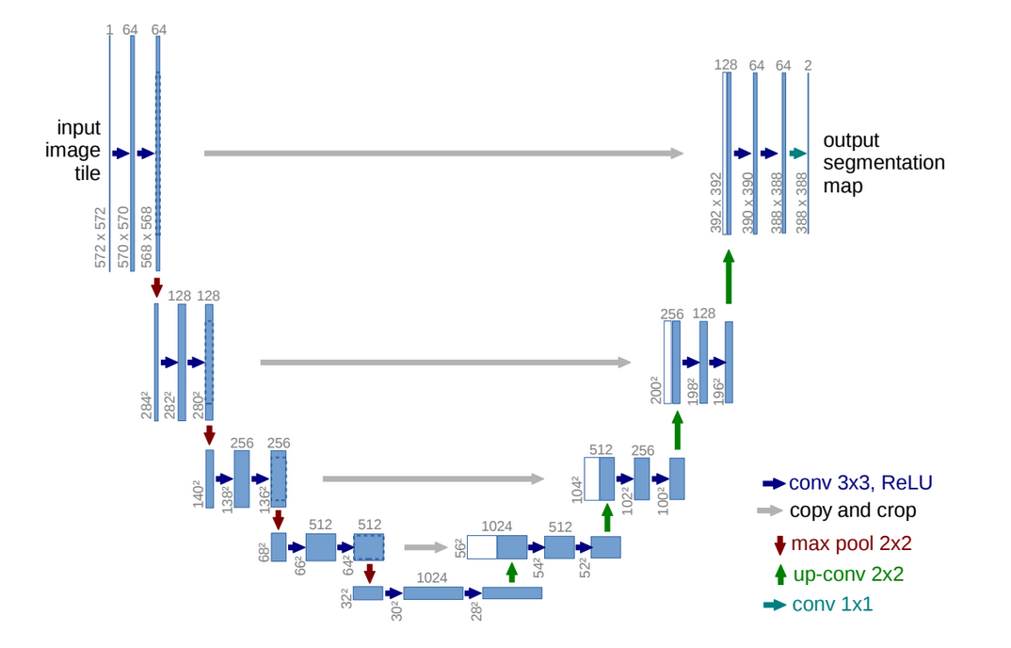
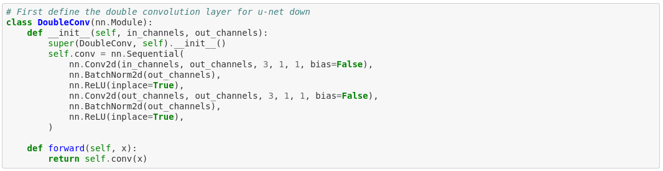
Implementation

Slide 9
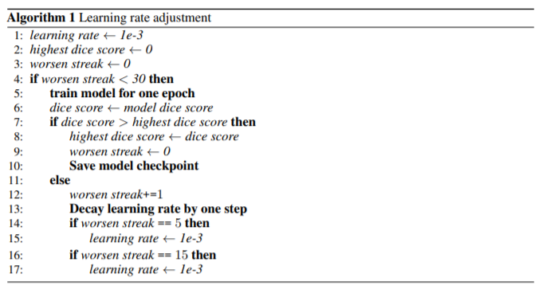
Dynamic learning rate adjustment

Slide 10
Result measurement
Key metrics
Pixel accuracy
Not a good metric
Dice coefficient
(2 x intersection) / (union + intersection)
Emphasizes correct pixel prediction on intersections

Slide 11
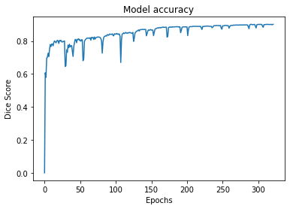
Model accuracy, validation, 91.2%

Slide 12
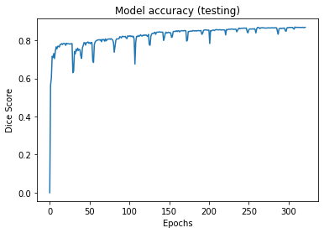
Model accuracy, testing, 86.4%

Slide 13
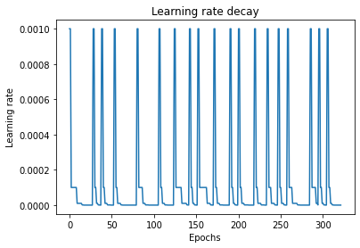
Learning rate decay

Slide 14
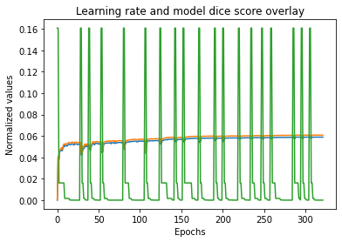
Dice coefficient and learning rate normalized

Slide 15
Previous Achievements
Mateusz Buda, Ashirbani Saha, Maciej A. Mazurowski. 2019. Association of genomic subtypes of lower-grade gliomas with shape features automatically extracted by a deep learning algorithm. Computers in Biology and Medicine (June 2019), 218-225. DOI:https://doi.org/10.1016/j.compbiomed.2019.05.002
In addition to segmentation, utilized biological identification to classify characteristics of these tumors
Dice coefficient of 82%
We achieved 86.4%, improvement of ~4.4%

Slide 16
Model Performance
Categorized problems into three sections
Expected performance
Excellent performance
Incorrect performance

Slide 17
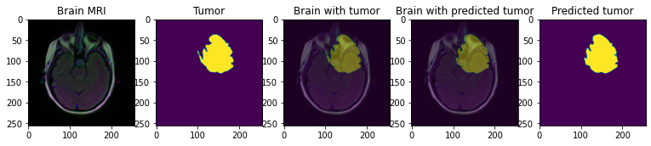
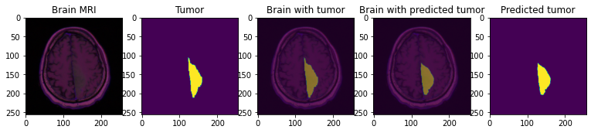
Expected performance

Slide 18
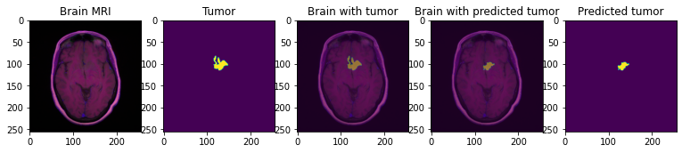
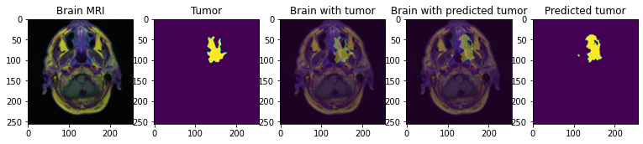
Excellent performance

Slide 19
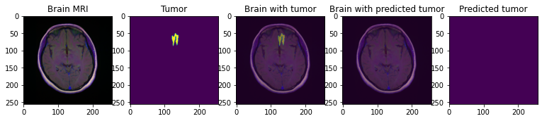
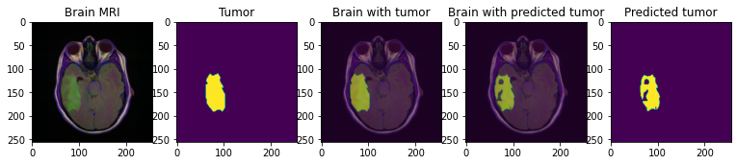
Incorrect performance

Slide 20
Limitations
Data size limitations
1007 MB total, 110 patients
Network architecture
Not a “faithful” recreation

Slide 21
Future Work
Test other model architectures
GoogLeNet (didn’t have enough time to implement and test)
Packaging
FaaS?
Edge deployment?
Data improvements
Network modifications

Slide 22
Q&A
Questions are welcome :)

Slide 23
Thank you!

